Slide 1
This is Times New Roman size 154
This is Times New Roman size 134
This is Times New Roman size 115
This is Times New Roman size 96
This is Times New Roman size 86
This is Times New Roman size 77
This is Times New Roman size 67
This is Times New Roman size 62
This is Times New Roman size 58
This is Times New Roman size 53
This is Times New Roman size 48
This is Times New Roman size 43
This is Times New Roman size 38
This is Times New Roman size 34
This is Times New Roman size 29
This is Times New Roman size 24
This is Times New Roman size 19
This is Times New Roman size 14
This is Times New Roman size 8
This is Times New Roman size 4 (smallest viewable at 400% zoom)
This is Times New Roman size 3
This is Calibri size 4
This is Calibri size 5 (smallest viewable at 400%)
This is Calibri size 19
This is Calibri size 24
This is Calibri size 29
This is Calibri size 34
This is Calibri size 38
This is Calibri size 43
This is Calibri size 48
This is Calibri size 53
This is Calibri size 58
This is Calibri size 62
This is Calibri size 67
This is Calibri size 77
This is Calibri size 86
This is Calibri size 96
This is Calibri size 115
This is Calibri size 134
This is Calibri size 154
This is Courier New size 2 (smallest visible at 400% zoom)
This is Courier New size 3 (smallest visible at 400% zoom)
This is Courier New size 8
This is Courier New size 14
This is Courier New size 19
This is Courier New size 24
This is Courier New size 29
This is Courier New size 38
This is Courier New size 43
This is Courier New size 48
This is Courier New size 53
This is Courier New size 58
This is Courier New size 62
This is Courier New size 67
This is Courier New size 77
This is Courier New size 86
This is Courier New size 96
This is Courier New size 115
This is Courier New size 134
This is Futura Condensed size 134
This is Futura Condensed size 115
This is Futura Condensed size 96
This is Futura Condensed size 86
This is Futura Condensed size 77
This is Futura Condensed size 67
This is Futura Condensed size 62
This is Futura Condensed size 53
This is Futura Condensed size 48
This is Futura Condensed size 43
This is Futura Condensed size 38
This is Futura Condensed size 34
This is Futura Condensed size 29
This is Futura Condensed size 24
This is Futura Condensed size 12
This is Futura Condensed size 5 (smallest viewable at 400% zoom)
This is Futura Condensed size 4 (smallest viewable at 400% zoom)

Slide 2

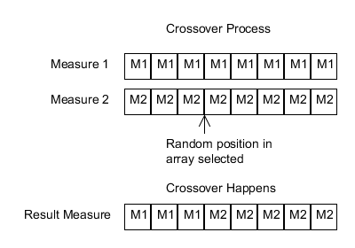
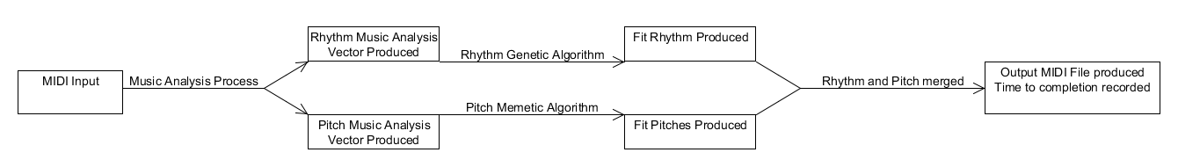
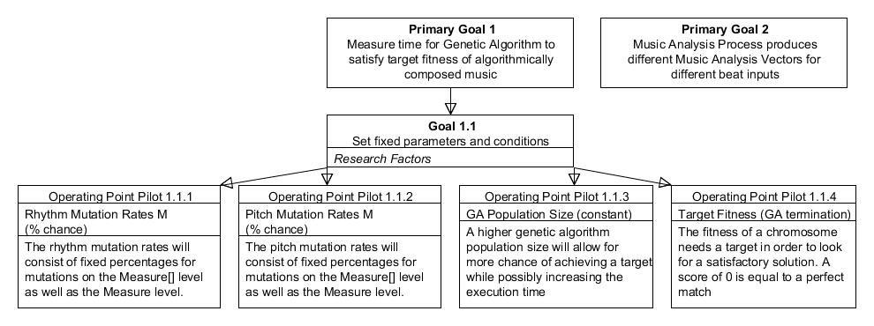
Digital Music Composition using Simultaneous Genetic Algorithms
Problem Statement
Solution Description
Musicians can become lacking in inspiration
Current genetic algorithm techniques are heavily dependent on an operator and are inherently subjective
Current genetic algorithm techniques generate rhythms and tones with a single algorithm, which may not be optimal
Input analyzed using Music Analysis Process: rhythmic and pitch music analysis vectors (MAV) produced
Rhythmic genetic algorithm executes using rhythmic MAV: Measure array of beats produced
Pitch memetic algorithm executes using pitch MAV: Measure array of pitches produced
Pitch and rhythm merged into MIDI output: time recorded
Primary Research Objective
To compose music using genetic and memetic algorithms by concurrently and separately processing the rhythmic and tonal components subject to the following criteria:
The level of effort shall not exceed 1 person month over 12 weeks
The rhythmic component will be limited to the following set: whole note, half note, quarter note, eighth note, sixteenth note, whole rest, half rest, quarter rest, eighth rest, sixteenth rest
All music is assumed to be composed in 4/4 time (4 beats to a measure)
Tied notes can be used by input and can be produced by the output
Dotted notes can be used by the input and can be produced by the output
The tonal component will be limited to the pitches available via the MIDI specification
The composed music will be presented in MIDI format
The input music will consist of 30 single instrument melodies ranging between 8 and 12 measures each
Experiment Design
For each input music:
Genetic algorithms for rhythm and tone execute (time is collected)
The results of the algorithms are combined into an output MIDI file (time is collected)
This was run 30 times per input
Goal Tree
Experiment Results
Of the 900 runs, 6 failed (.67%)
The average time with failures present was 27.04s +- 43.7s
The average time with failures removed was 24.7s += 32.7s
Conclusion
The algorithms developed performed well and created music that is aesthetically pleasing and did so very quickly and reliably. This makes them a promising solution to the problem of algorithmic music composition.
Stephen Bussey with Mentor Dr. Alice Armstrong

